Slide 1
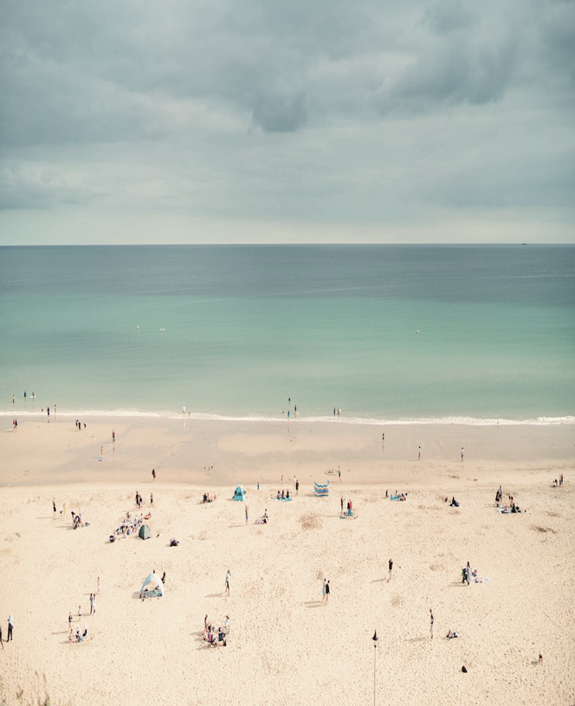
SAFARNAMA
- “Har Kadam Par Prakriti Ka Saath”
- Raj Roy (DC2022BCA0029)
- Aman Sah (DC2022BCA0025)
- Bisant Chowdhury (DC2022BCA0035)

Slide 2
CONTENT
Introduction
Objectives
Problem Statement
Feasibility Study
Technical Feasibility
Operational Feasibility
Economic Feasibility
Schedule Feasibility
Design Diagrams
Use Case Diagram
Class Diagram
Activity Diagram
Conclusion

Slide 3
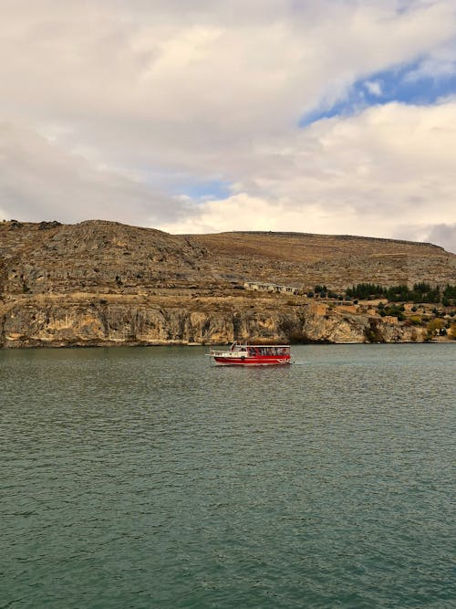
INTRODUCTION
SAFARNAMA:“Har Kadam Par Prakriti Ka Saath”
The Platform’s name represents “Journey” with nature. It promotes friendly travel experiences that connect users with nature and local communities while emphasizing responsible travel practices.

Slide 4
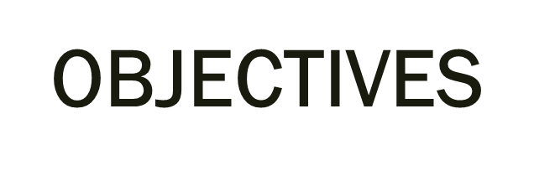

Create a Comprehensive Travel Planning System
Booking options for accommodations, transportation, and customized itineraries.
Filters for activities and destinations based on user preferences like wildlife, hiking or cultural experiences.

Slide 5

2. Build a Community-Driven Environment
Encourage user-generated content, forums and discussions about sustainable travel practices.
Promote the sharing of travel experiences and knowledge for creating an eco-conscious community.

Slide 6

3. Integrate Educational Resources
Educate user about sustainable tourism practices and their ecological impact.
Provide articles, blogs, videos, infographics and interactive quizzes.
Tackle topics like conserving natural habitats, reducing carbon footprints and supporting local communities.

Slide 7
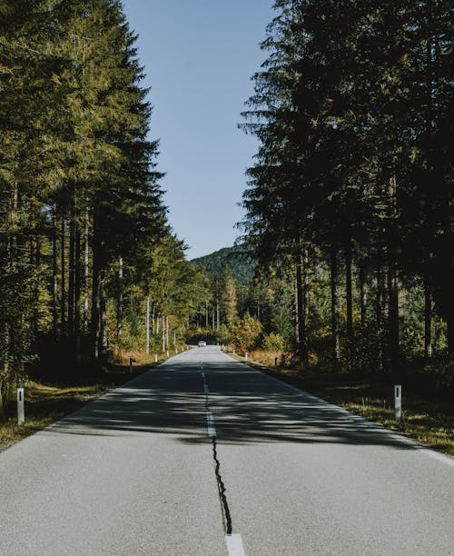
4. Promote Off-Beat Eco-Tourism Areas
Highlight lesser-known tourism destinations.
Dynamically updated contents based on user inputs and environmental data.
Showcase hidden gems, relieving pressure from popular destinations and boosting local economies.

Slide 8
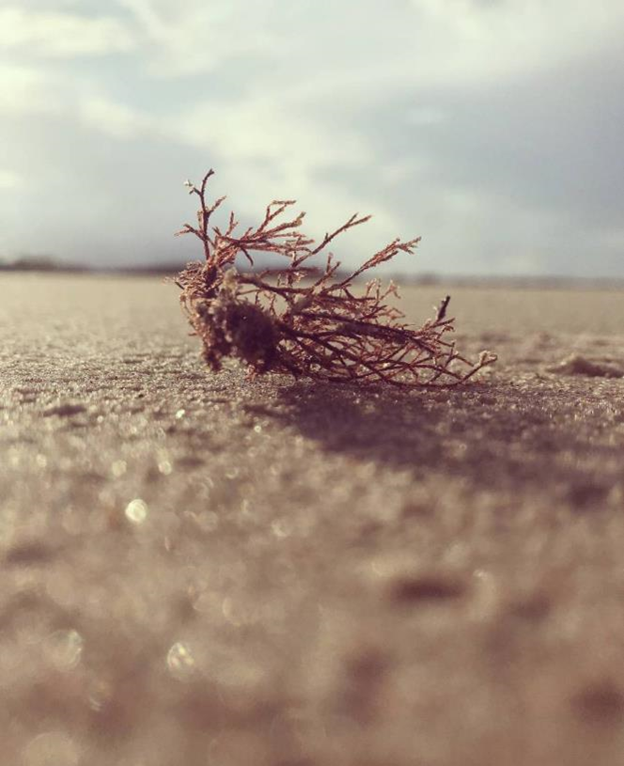
5. Connect Travelers with Nature at a Deeper Level
Strengthen the bond between travelers and nature.
Offer guided walks, conservation projects and sustainability workshops.
Encourage reflection and appreciation for natural habitats.

Slide 9
PROBLEM STATEMENT
Q1
Lack of Comprehensive Platform.
Q2
Insufficient Awareness..
Q3
Poor User Experience.

Slide 10
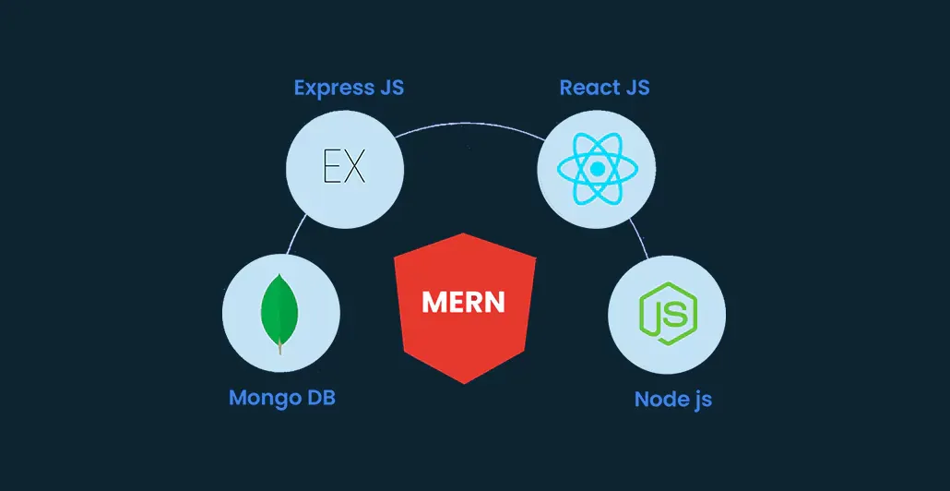
FEASIBILITY STUDY
Technical Feasibility :
Hardware Requirements: Development machines (i5,8GB RAM, 256GB SSD, 10 MBPS Speed), User Machines (i3, 4GB RAM, 50GB SSD, 2MBPS Speed), servers (Quad-core 2.5GHz, 8GB RAM, 500GB SSD,high bandwidth), backup storage (Hard drives/Cloud Storage 1TB), Networking (Routers, Switches, Firewalls).
Software Requirements: Operating systems (Windows, Mac OS, Ubuntu), Development tools (VS, Node.js,Thunder Client), Web Frameworks (React.js, Express.js), Design (Figma ),Database (Mongo DB).

Slide 11

2. Operational Feasibility : Skills required: React.js, Node.js, Mongo DB . Support: Continuous support and maintenance for a functional, secure and updated platform. User Acceptance: Focus on user-friendly navigation and regular user testing.

Slide 12
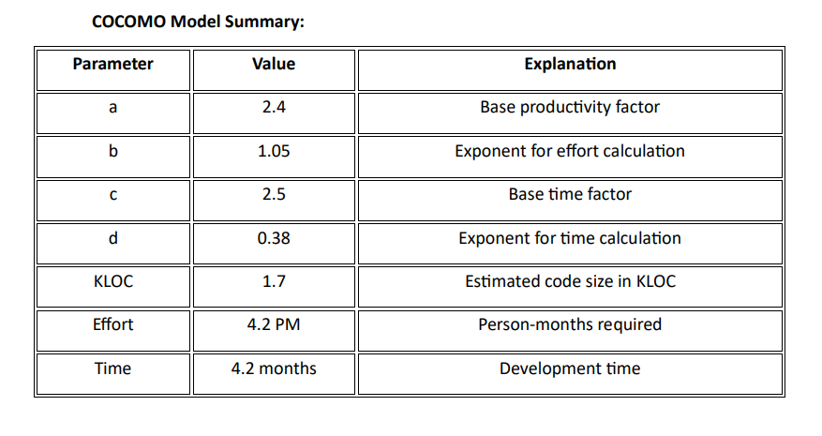
3. Economic Feasibility :
COCOMO Model: Estimates cost and effort for software development.
Effort: 4.2 person-months to develop.
Development Time: Approximately 4.2 months.

Slide 13
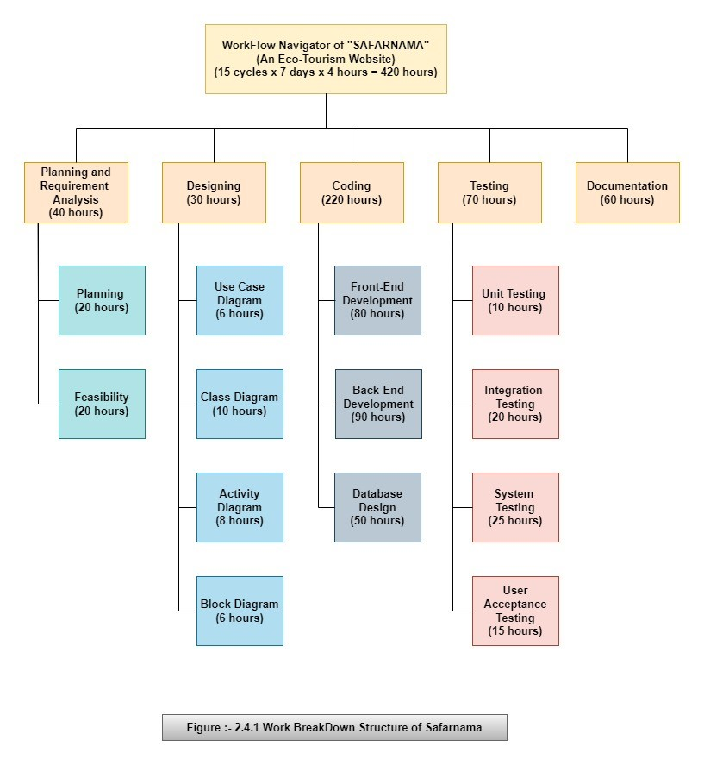
4. Schedule Feasibility : Work Breakdown Structure (WBS): Break down the project into manageable tasks.

Slide 14
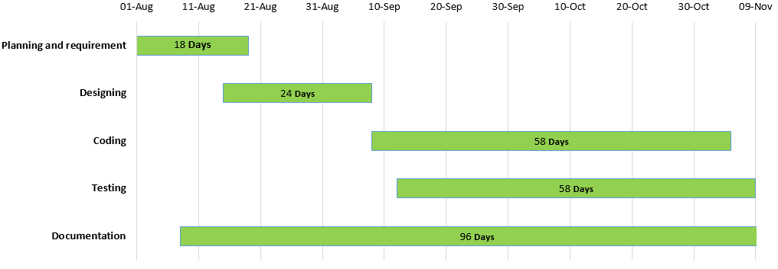
4. Schedule Feasibility : Gantt Chart: Visualize the project timeline, ensuring all projects are completed on time.

Slide 15
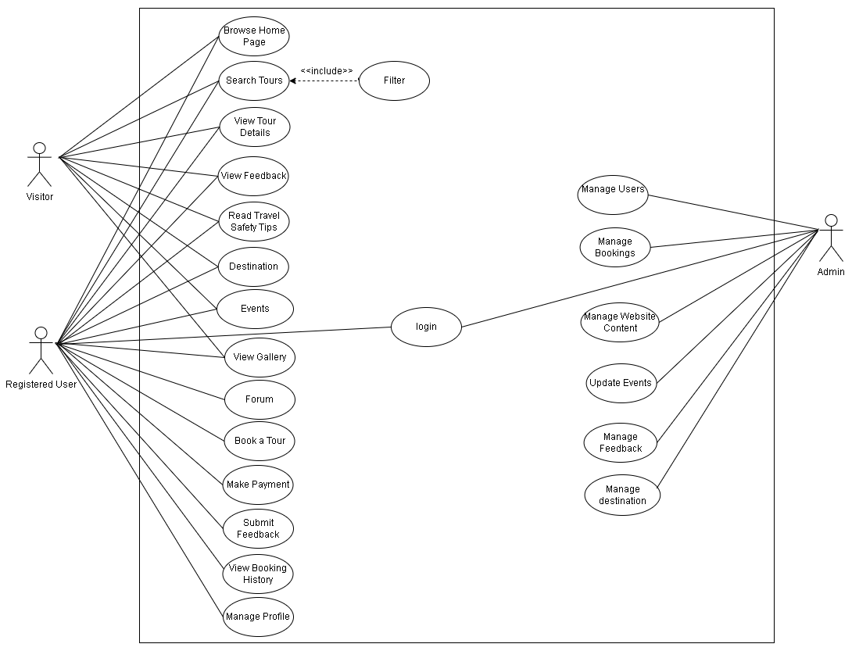
DESIGN DIAGRAMS
Use Case Diagram

Slide 16
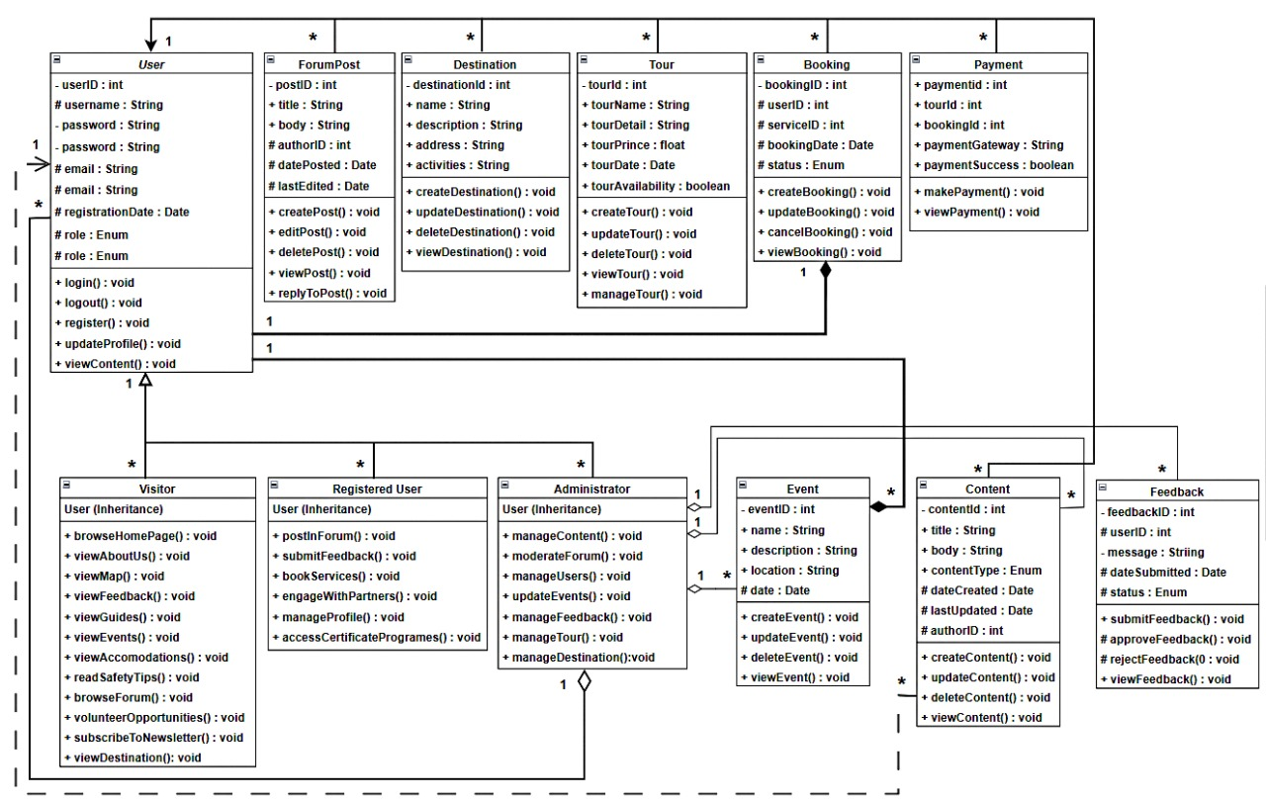
2. Class Diagram

Slide 17
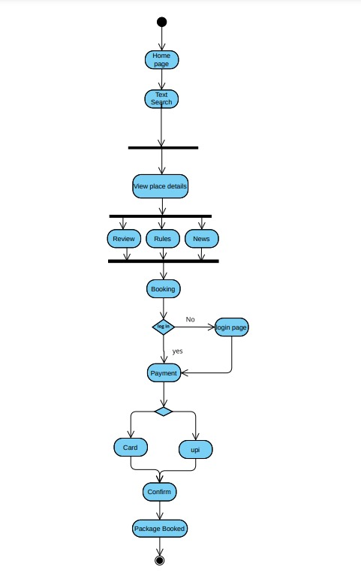
3. Activity Diagram

Slide 18
CONCLUSION
SAFARNAMA fills a gap in tourism by providing a comprehensive platform for responsible travel. It integrates cutting-edge web technologies (MERN stack) and promotes sustainable tourism with its interactive, community-driven platform.
SAFARNAMA is more than just a travel platform—it's a pioneering initiative aimed at reshaping the way people travel by encouraging conscious tourism. Through its dynamic features, the platform connects users with nature, local communities, and cultural heritage in a meaningful way.

Slide 19
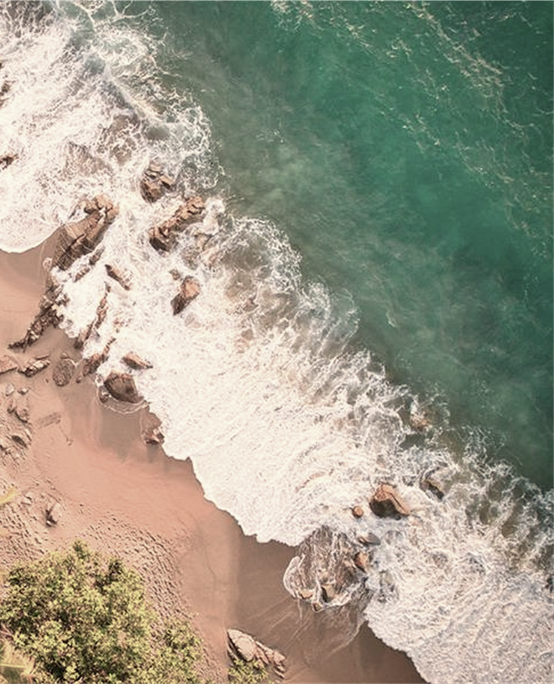
THANK YOU

